Slide 1
Partner Technical Boot Camp
Infrastructure and Management

Slide 2
Track Kick-off

Slide 3
Agenda

Slide 4
Speakers
Ryan Puffer, Microsoft
Libby Zorn, Microsoft
Jian Yan, Microsoft
Archana Balakrishnan, Microsoft
Nikhil Jethava, Microsoft
Chris Sanders, Microsoft
Vinoo Srinivas Murali, Microsoft
Jonathan Tuliani, Opsgility
Scott Hoag, Opsgility

Slide 5
Coaches
Ameen Uddin | Ifeanyi Aneke | Mathieu Rietman | Sarmad Jari
Balazs Vizi | Jeff Wagner | Mike Martin | Senthilkumar Gurusamy
Bart Roels | Jonathan Vella | Niels Ophey | Sireesha Mudapaka
Chris Jeffrey | Joni Leskinen | Peter Sandin | Terje Island
David Pazdera | Maarten Wiese | Rodrigo Fonseca | Zach Olinske
Eric Pelletier | Manish Choudhary | Ronald Van Teeffelen
Farkas Lorand | Marc de Droog | Sam Khanjar

Slide 6
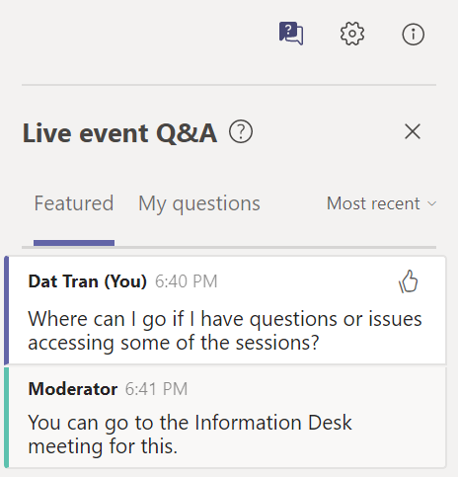
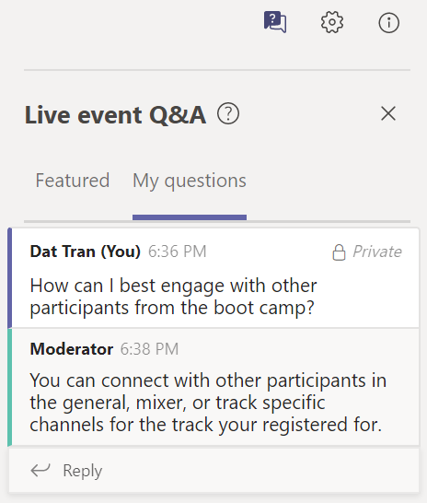
Q&A tool in event
How to submit a question
Select Q&A on the right side of the screen.
Type your question in the compose box, and then select Send.
Two types of responses
Featured
Announcements from the moderators
Public responses to questions asked
My Questions – Private responses to your questions
We will try to get through as many questions as we can, but may not be able to answer all the question

Slide 7
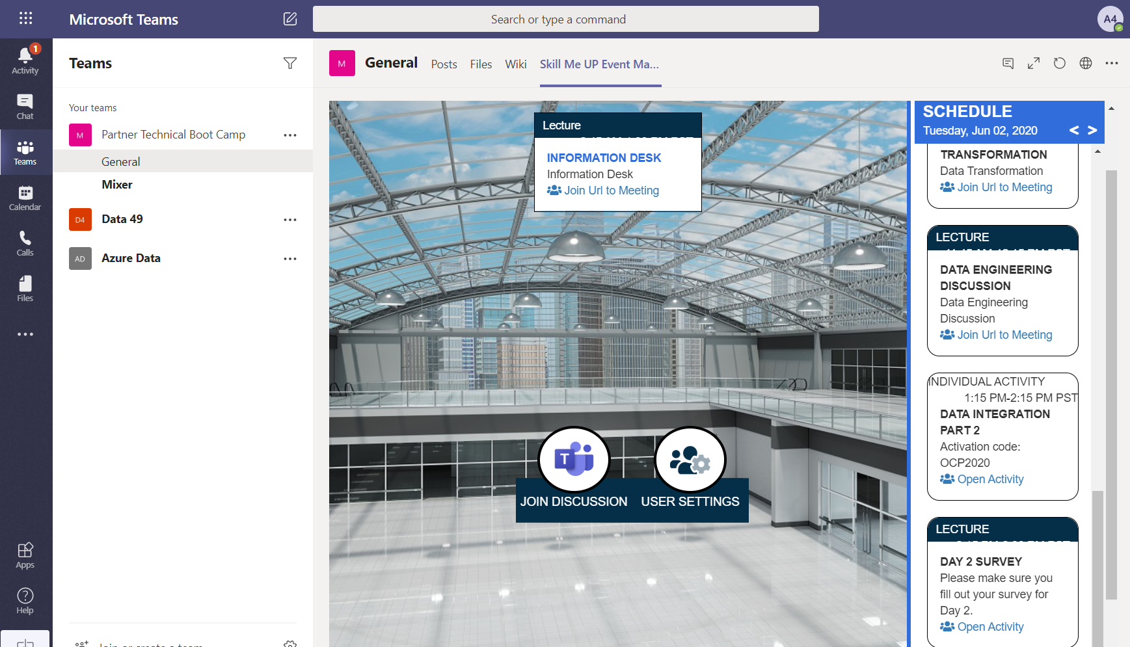
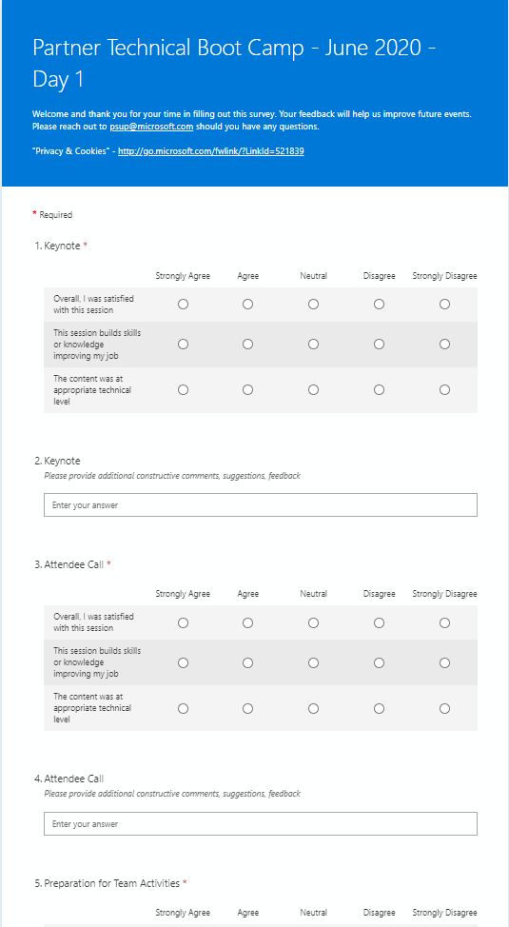
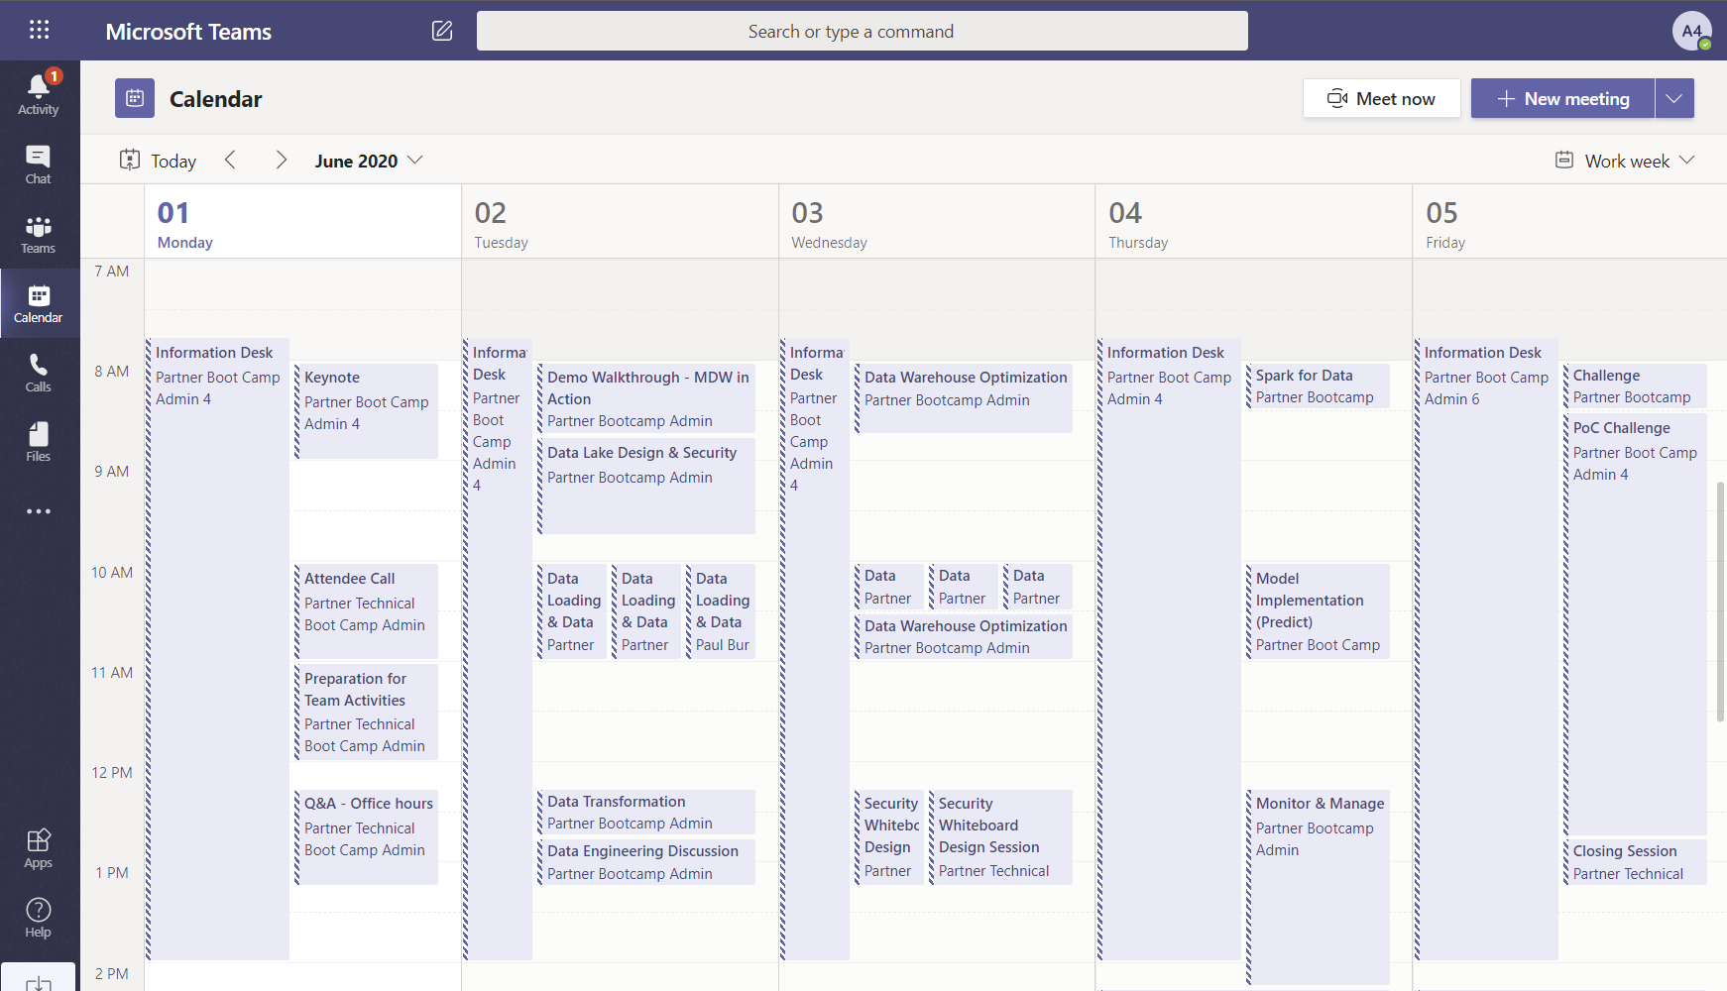
Survey
Daily

Slide 8
Thank you.

